Slide 1


MATH 242
Analytic Geometry and Calculus B
Section 12
Instructor: Jacob Wyngaard
Trig Substitution

Slide 2

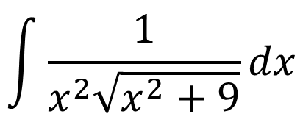
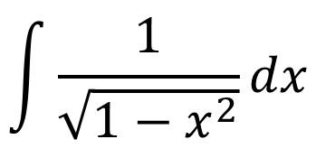

Background
  Last class, we reviewed some important trig identities
  In that lecture, we learned how to use those identities to solve trick trigonometric integrals
  In this lecture, we’re going to use those identities to solve tricky integrals involving square roots and polynomials
$${\sin^{2}\left(θ\right)+cos}^{2}(θ) = 1$$
$$\sec^{2}\left(θ\right)= \tan^{2}\left(θ\right)+1$$
$$\int{\frac{1}{x^{2}\sqrt{x^{2}+9}}dx}$$
$$\int{\frac{1}{\sqrt{1−x^{2}}}dx}$$

Slide 3
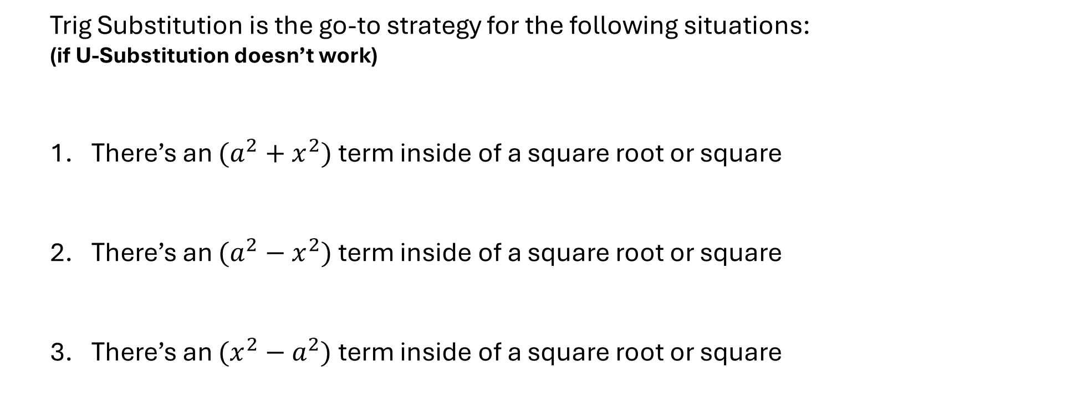
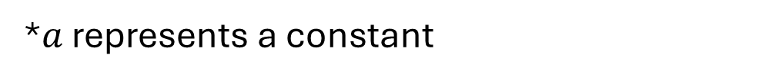



The Set-Up
  Trig Substitution is the go-to strategy for the following situations:
  (if U-Substitution doesn’t work)
  There’s an $(a^{2}+x^{2})$ term inside of a square root or square
  There’s an $(a^{2}−x^{2})$ term inside of a square root or square
  There’s an $(x^{2}−a^{2})$ term inside of a square root or square
$$\int{\frac{1}{x^{2}\sqrt{x^{2}+9}}dx}$$
$$\int{\frac{1}{\sqrt{1−x^{2}}}dx}$$
$$\int{\frac{1}{\sqrt{x^{2}−4}}dx}$$
*$a$ represents a constant

Slide 4

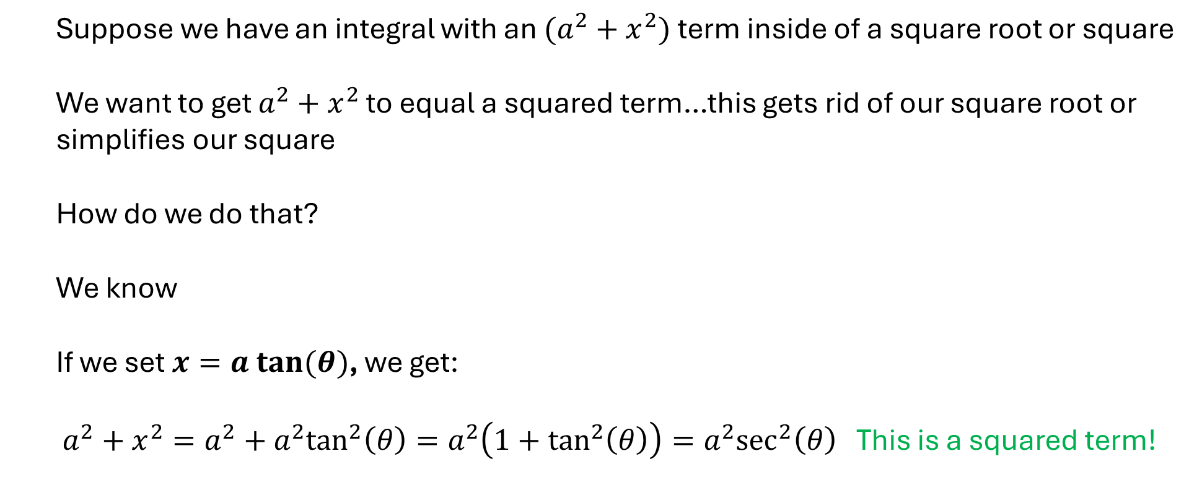
  Case 1: $(a^{2}+x^{2})$ term inside square/square root
  Suppose we have an integral with an $(a^{2}+x^{2})$ term inside of a square root or square
  We want to get $a^{2}+x^{2}$ to equal a squared term…this gets rid of our square root or simplifies our square
  How do we do that?
  We know
  If we set $x=a tan⁡(θ)$, we get:
  $a^{2}+x^{2}=a^{2}+a^{2}\tan^{2}\left(θ\right)=a^{2}\left(1+\tan^{2}\left(θ\right)\right)=a^{2}\sec^{2}\left(θ\right)$ This is a squared term!
$$\sec^{2}\left(θ\right)= {1+tan}^{2}\left(θ\right)$$

Slide 5
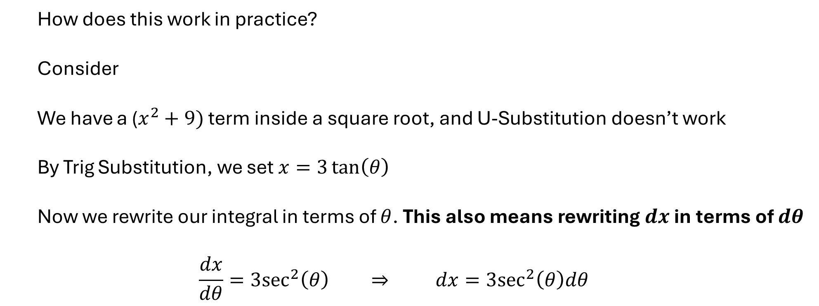

  Case 1: $(a^{2}+x^{2})$ term inside square/square root
  How does this work in practice?
  Consider
  We have a ($x^{2}+9)$ term inside a square root, and U-Substitution doesn’t work
  By Trig Substitution, we set $x=3\tan\left(θ\right)$
  Now we rewrite our integral in terms of $θ$. This also means rewriting $dx$ in terms of $dθ$
  $$\frac{dx}{dθ}=3\sec^{2}\left(θ\right) ⇒ dx=3\sec^{2}\left(θ\right)dθ$$
$$\int{\frac{1}{x^{2}\sqrt{x^{2}+9}}dx}$$

Slide 6
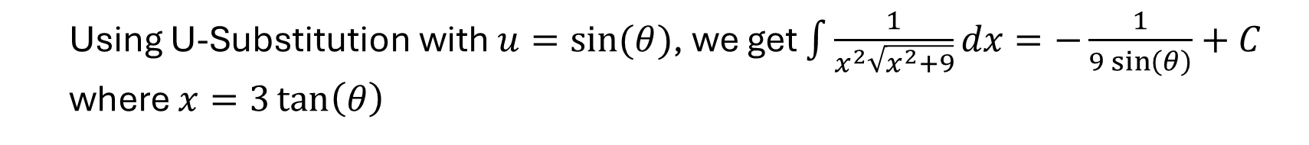
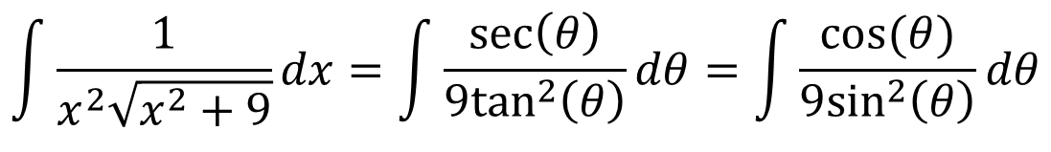
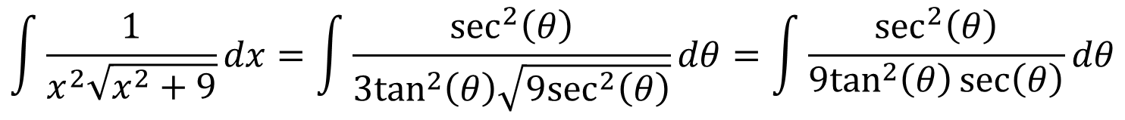
  Case 1: $(a^{2}+x^{2})$ term inside square/square root
$$\int{\frac{1}{x^{2}\sqrt{x^{2}+9}}dx}=\int{\frac{3\sec^{2}\left(θ\right)}{{9tan}^{2}\left(θ\right)\sqrt{{9tan}^{2}\left(θ\right)+9}}dθ=\int{\frac{\sec^{2}\left(θ\right)}{{3tan}^{2}\left(θ\right)\sqrt{{9(tan}^{2}\left(θ\right)+1)}}dθ}}$$
$$\int{\frac{1}{x^{2}\sqrt{x^{2}+9}}dx}=\int{\frac{\sec^{2}\left(θ\right)}{{3tan}^{2}\left(θ\right)\sqrt{{9sec}^{2}\left(θ\right)}}dθ=\int{\frac{\sec^{2}\left(θ\right)}{{9tan}^{2}\left(θ\right)\sec\left(θ\right)}dθ}}$$
$$\int{\frac{1}{x^{2}\sqrt{x^{2}+9}}dx}=\int{\frac{\sec\left(θ\right)}{{9tan}^{2}\left(θ\right)}dθ=\int{\frac{cos⁡(θ)}{{9sin}^{2}\left(θ\right)}dθ}}$$
  Using U-Substitution with $u=sin⁡(θ)$, we get $\int{\frac{1}{x^{2}\sqrt{x^{2}+9}}dx}=−\frac{1}{9\sin\left(θ\right)}+C$ where $x=3\tan\left(θ\right)$

Slide 7
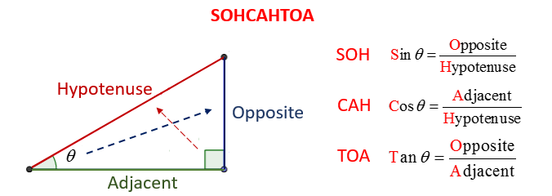
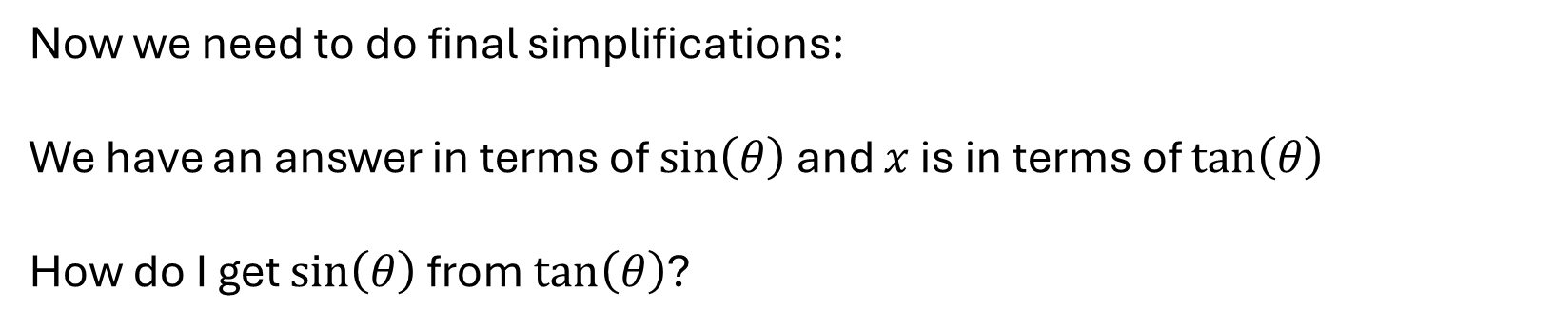
  Case 1: $(a^{2}+x^{2})$ term inside square/square root
Now we need to do final simplifications:
We have an answer in terms of $\sin\left(θ\right)$ and $x$ is in terms of $\tan\left(θ\right)$
How do I get $\sin\left(θ\right)$ from $\tan\left(θ\right)$?

Slide 8
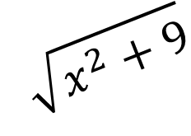



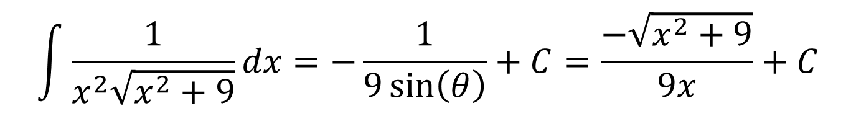
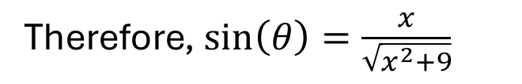
  Case 1: $(a^{2}+x^{2})$ term inside square/square root
We know $x=3\tan\left(θ\right)$ so $\tan\left(θ\right)= \frac{x}{3}$
$$\sqrt{x^{2}+9}$$
$$x$$
$$θ$$
$$3$$
Therefore, $\sin\left(θ\right)=\frac{x}{\sqrt{x^{2}+9}}$
$$\int{\frac{1}{x^{2}\sqrt{x^{2}+9}}dx}=−\frac{1}{9\sin\left(θ\right)}+C=\frac{−\sqrt{x^{2}+9}}{9x}+C$$

Slide 9

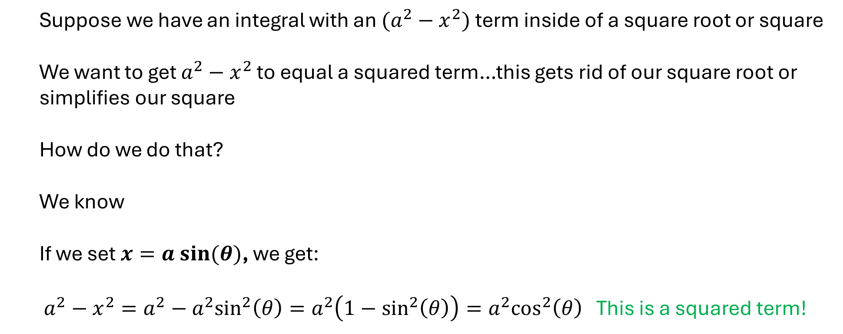
  Case 2: $(a^{2}−x^{2})$ term inside square/square root
  Suppose we have an integral with an $(a^{2}−x^{2})$ term inside of a square root or square
  We want to get $a^{2}−x^{2}$ to equal a squared term…this gets rid of our square root or simplifies our square
  How do we do that?
  We know
  If we set $x=a sin⁡(θ)$, we get:
  $a^{2}−x^{2}=a^{2}−a^{2}\sin^{2}\left(θ\right)=a^{2}\left(1−\sin^{2}\left(θ\right)\right)=a^{2}\cos^{2}\left(θ\right)$ This is a squared term!
$$\cos^{2}\left(θ\right)=1−\sin^{2}\left(θ\right)$$

Slide 10
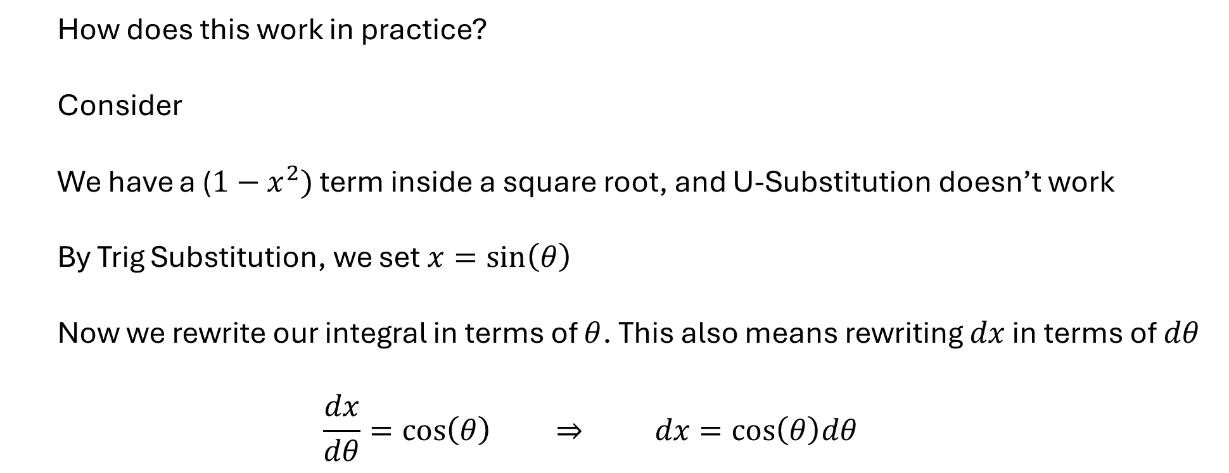

  Case 2: $(a^{2}−x^{2})$ term inside square/square root
  How does this work in practice?
  Consider
  We have a ($1−x^{2})$ term inside a square root, and U-Substitution doesn’t work
  By Trig Substitution, we set $x=\sin\left(θ\right)$
  Now we rewrite our integral in terms of $θ$. This also means rewriting $dx$ in terms of $dθ$
  $$\frac{dx}{dθ}=cos\left(θ\right) ⇒ dx=cos\left(θ\right)dθ$$
$$\int{\frac{1}{\sqrt{1−x^{2}}}dx}$$

Slide 11
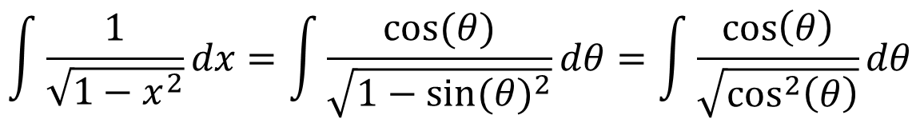
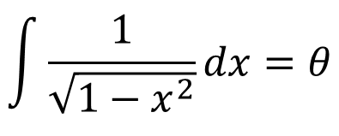
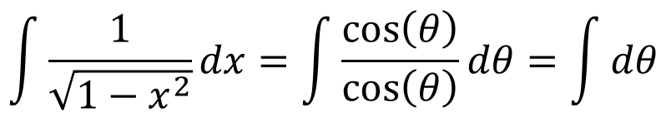
  Case 2: $(a^{2}−x^{2})$ term inside square/square root
$$\int{\frac{1}{\sqrt{1−x^{2}}}dx}=\int{\frac{cos⁡(θ)}{\sqrt{1−{sin⁡(θ)}^{2}}}dθ=\int{\frac{cos\left(θ\right)}{\sqrt{\cos^{2}\left(θ\right)}}dθ}}$$
$$\int{\frac{1}{\sqrt{1−x^{2}}}dx}=\int{\frac{cos\left(θ\right)}{cos\left(θ\right)}dθ=\int{dθ}}$$
$$\int{\frac{1}{\sqrt{1−x^{2}}}dx}=θ$$
  Since $x=sin⁡(θ)$, $\int{\frac{1}{\sqrt{1−x^{2}}}dx}=arcsin⁡(x)$

Slide 12


  Case 3: $(x^{2}−a^{2})$ term inside square/square root
  Suppose we have an integral with an $(x^{2}−a^{2})$ term inside of a square root or square
  We want to get $x^{2}−a^{2}$to equal a squared term…this gets rid of our square root or simplifies our square
  How do we do that?
  We know
  If we set $x=a sec⁡(θ)$, we get:
  $a^{2}−x^{2}=a^{2}\sec^{2}\left(θ\right)−a^{2}=a^{2}\left(\sec^{2}\left(θ\right)−1\right)=a^{2}\tan^{2}\left(θ\right)$ This is a squared term!
$$\tan^{2}\left(θ\right)=\sec^{2}\left(θ\right)−1$$

Slide 13
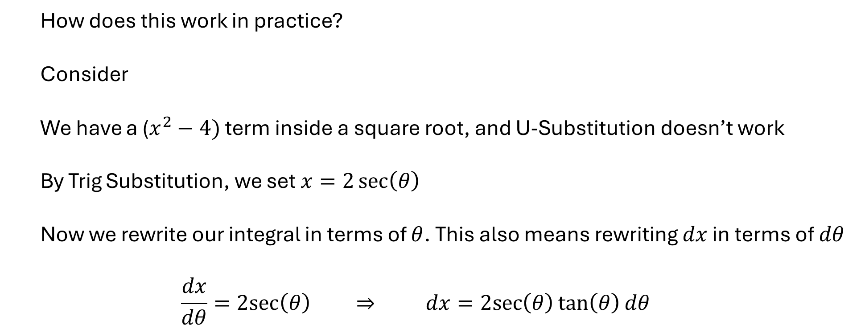

  Case 3: $(x^{2}−a^{2})$ term inside square/square root
  How does this work in practice?
  Consider
  We have a ($x^{2}−4)$ term inside a square root, and U-Substitution doesn’t work
  By Trig Substitution, we set $x=2\sec\left(θ\right)$
  Now we rewrite our integral in terms of $θ$. This also means rewriting $dx$ in terms of $dθ$
  $$\frac{dx}{dθ}=2sec\left(θ\right) ⇒ dx=2sec\left(θ\right)\tan\left(θ\right)dθ$$
$$\int{\frac{1}{\sqrt{x^{2}−4}}dx}$$

Slide 14
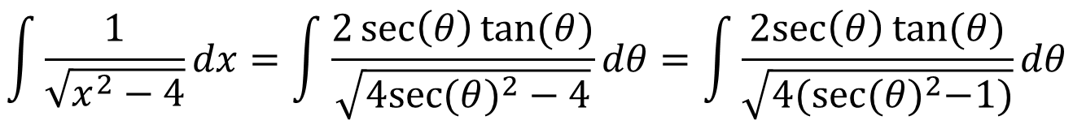
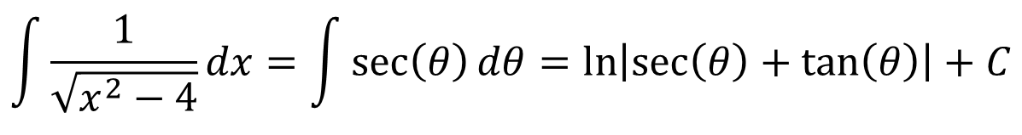
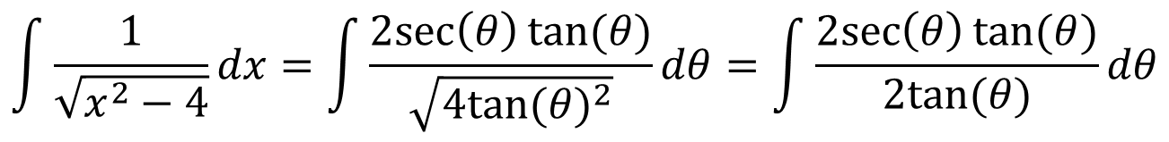
  Case 2: $(a^{2}−x^{2})$ term inside square/square root
$$\int{\frac{1}{\sqrt{x^{2}−4}}dx}=\int{\frac{2\sec\left(θ\right)tan⁡(θ)}{\sqrt{4{sec⁡(θ)}^{2}−4}}dθ=\int{\frac{2sec\left(θ\right)tan⁡(θ)}{\sqrt{4{(sec⁡(θ)}^{2}−1)}}dθ}}$$
$$\int{\frac{1}{\sqrt{x^{2}−4}}dx}=\int{\frac{2sec\left(θ\right)tan⁡(θ)}{\sqrt{4{tan⁡(θ)}^{2}}}dθ}=\int{\frac{2sec\left(θ\right)tan⁡(θ)}{2tan⁡(θ)}dθ}$$
$$\int{\frac{1}{\sqrt{x^{2}−4}}dx}=\int{\sec\left(θ\right)dθ=\ln\left|\sec\left(θ\right)+\tan\left(θ\right)\right|+C}$$

Slide 15


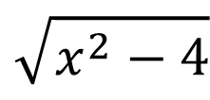
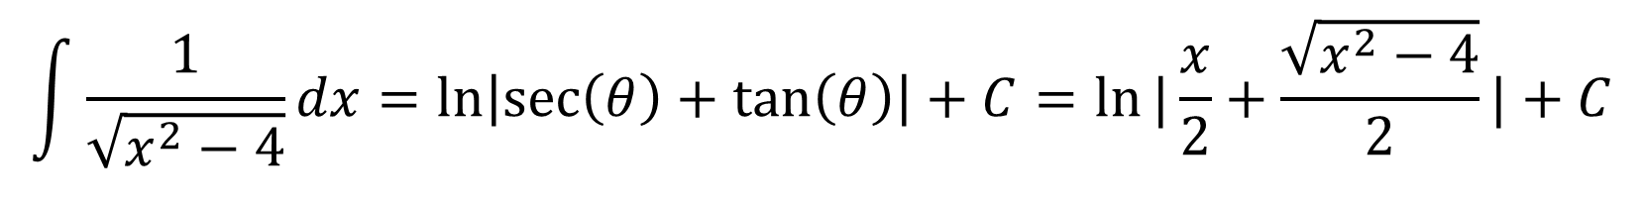
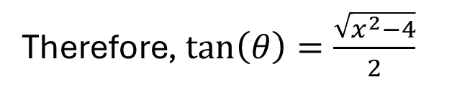
  Case 1: $(a^{2}+x^{2})$ term inside square/square root
We know $x=2\sec\left(θ\right)$ so $\sec\left(θ\right)= \frac{x}{2}$
$$x$$
$$\sqrt{x^{2}−4}$$
$$θ$$
$$2$$
Therefore, $\tan\left(θ\right)=\frac{\sqrt{x^{2}−4}}{2}$
$$\int{\frac{1}{\sqrt{x^{2}−4}}dx}=\ln\left|\sec\left(θ\right)+\tan\left(θ\right)\right|+C=ln⁡|\frac{x}{2}+\frac{\sqrt{x^{2}−4}}{2}|+C$$

